Slide 1
DATA TRANSFER SCHEMES
MODULE 4

Slide 2
NEED OF DATA TRANSFER SCHEMES
Usually speed of I/O devices is less as compared to the processor speed.
A slow responding I/O device cannot transfer data when microprocessor issues the instruction for it, as it takes some time to get ready.

Slide 3
Data Transfer Schemes
Classified as:
Programmed Data Transfer Scheme
DMA(Direct Memory Access) Data Transfer Scheme

Slide 4
PROGRAMMED DATA TRANSFER
Simplest data transfer scheme.
Controlled by CPU.
Used for parallel data transfer.
Data are transferred from an I/O device to CPU or to the memory or vice versa , under the control of programs which resides in memory.
These programs are executed by CPU , when an I/O device is ready to transfer data.
Used for transferring small amount of data.

Slide 5
TYPES OF PROGRAMMED DATA TRANSFER SCHEMES
Synchronous Data Transfer Scheme
Asynchronous Data Transfer Scheme
Interrupt Driven Data Transfer Scheme

Slide 6
a) Synchronous Data Transfer
Means “at the same time”.
The device which sends data and the device which receives data are synchronized with the same clock.
If the speed of the I/O device is same as that of the speed of the microprocessor , synchronous data transfer can be achieved.
Here, the status of I/O device , whether it is ready or not is not examined before the data is transferred.

Slide 7
This technique is rarely used for I/o Devices.
Speed of the I/O devices is not compatible with the speed of microprocessor.
Used invariably with compatible memory devices.
Instructions for data transfer:
IN and OUT for I/O mapped I/O devices
MOV M,A etc. for memory mapped I/O

Slide 8
b) Asynchronous Data Transfer
Means “at irregular intervals”.
Not based on pre-determined timing pattern.
When the I/O device speed and microprocessor speed do not match, asynchronous mode may be used.
MPU initiates data transfer by requesting the device to get ready.
Each data transfer is preceded by a request ready signal generated by MPU and an acknowledgement signal issued by I/O device.
This method is known as handshaking method of data transfer.
Software and hardware approach is there for asynchronous data transfer.

Slide 9
Software approach
The microprocessor initiates I/O device to get ready then continuously checks the status of the device till the I/O device becomes ready to transfer data.
Hardware approach :
When I/O device or memory chip becomes ready to transfer data, it makes the READY signal high.
If the READY signal is low, MP enters a wait state.
Processing time is wasted due to waiting of the processor.

Slide 10
Asyncronous Data Transfer
Microprocessor
I/O Device
Data
Status
Start

Slide 11
Asyncronous Data Transfer for A/D Converter
Microprocessor
I/O Device
Data
PORT
E/C
PORT
S/C

Slide 12
Drawbacks of Synchronous & Asynchronous data transfer schemes
CPU is too busy
Waiting time of CPU is more.

Slide 13
c) Interrupt Driven Data Transfer
To overcome the drawbacks of synchronous and asynchronous modes of data transfer , interrupt driven mode has been developed.
When the device is ready to accept or supply data it informs the processor through interrupt line( INTR).
Then processor completes current instruction, saves the content of PC in stack and branches to ISR.

Slide 14
Interrupt Driven Data Transfer
Microprocessor
I/O Device
INTR request
Data
INTR acknowledged

Slide 15
Interrupt driven data transfer for an A/D converter
Microprocessor
I/O Device
Data
INTR
E/C
PORT
S/C

Slide 16
Drawbacks of Interrupt Driven Data Transfer
The normal operation of the microprocessor is interrupted.
need to continuous monitoring of interrupt signals

Slide 17
DMA- Direct Memory Access
CPU does not participate.
I/O devices are allowed to transfer data directly from I/O device to the external memory or vice versa bypassing the microprocessor.
This scheme is employed when large amount of data is to be transferred.
Used for serial data transfer.
Used to transfer data from mass storage devices such as hard disk .
DMA scheme is faster as compared to programmed data transfer scheme.

Slide 18
When an I/O device want to send data using DMA,
Sends a HOLD signal to the CPU.
On receiving HOLD signal, the CPU gives up the control of the bus as son as the current machine cycle is completed.
CPU sends a HLDA signal to the I/O device, indicating that it has received HOLD and released the buses.
I/O device can take control of the buses and initiate the transfer.

Slide 19
DMA Singnals
DMA ack
Microprocessor
I/O Device
DMA request
Address of I/O device
Data

Slide 20
BURST MODE DMA TRANSFER
The I/O device withdraws the DMA request only after all the data bytes have been transferred.
ie, once initiated, the data transfer process does not stop until the complete block is transferred.
This method is employed in magnetic disk drives

Slide 21
CYCLE STEALING TECHNIQUE
After transferring one byte or several bytes, the I/O device withdraws the DMA request.
This method reduces the interference to the MP’s activities.

Slide 22
8257- DMA Controller
It is a device to transfer the data directly between IO device and memory without through the CPU.
So it performs a high speed data transfer between memory and I/O device.

Slide 23
Features of 8257
has four channels and so it can be used to provide DMA to four I/O devices .
Each channel can be independently programmable to transfer up to 64kb of data by DMA.
Each channel can be independently perform read transfer,write transfer and verify transfer.
It is a 40 pin IC.
Primarily generates sequential memory address, upon peripheral request which will allow the peripheral to read or write data directly to or from memory without going through the MP.

Slide 24
Has priority logic that resolves the peripheral requests and issues a composite hold request to the MP.
Maintains DMA cycle count for each channel and outputs a control signal to notify the peripheral that the programmed number of DMA cycles is complete.

Slide 25
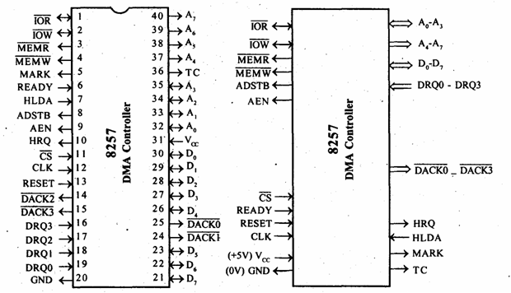
8257-DMA Controller

Slide 26
Signal Description
DRQo-DRQ3
The four individual channel DMA request inputs, used by the peripheral devices for requesting the DMA services.
The DRQo has the highest priority while DRQ3 has the lowest one, if the fixed priority mode is selected.
DACKo-DACK3
Active-low DMA acknowledge output lines which inform the requesting peripheral that the request has been honoured and the bus is relinquished by the CPU.
These lines may act as strobe lines for the requesting devices.

Slide 27
Do-D7
are bidirectional, data lines used to interface the system bus with the internal data bus of 8257.
Carry command words to 8257 and status word from 8257, in slave mode, i.e. under the control of CPU.
When the 8257 is the bus master (master mode, i.e. not under CPU control), it uses Do-D7 lines to send higher byte of the generated address to the latch.
This address is further latched using ADSTB signal.
The address is transferred over Do-D7 during the first clock cycle of the DMA cycle.
During the rest of the period, data is available on the data bus.

Slide 28
IOR
an active-low bidirectional tristate input line that acts as an input in the slave mode.
In slave mode, this input signal is used by the CPU to read internal registers of 8257.
This line acts output in master mode.
In master mode, this signal is used to read data from a peripheral during a memory write cycle

Slide 29
IOW
An active low bidirectional tri-state line that acts as input in slave mode
Load the contents of the data bus to the 8-bit mode register or upper/lower byte of a 16-bit DMA address register or terminal count register.
In the master mode, it is a control output that loads the data to a peripheral during DMA memory read cycle (write to peripheral).

Slide 30
CLK:
clock frequency input required to derive basic system timings for the internal operation of 8257.
RESET :
active-high asynchronous input disables all the DMA channels by clearing the mode register and tristates all the control lines.

Slide 31
Ao-A3:
the four least significant address lines.
In slave mode, they act as input which select one of the registers to be read or written.
In the master mode, they are the four least significant memory address output lines generated by 8257.

Slide 32
CS:
An active-low chip select line that enables the read/write operations from/to 8257, in slave mode.
In the master mode, it is automatically disabled to prevent the chip from getting selected (by CPU) while performing the DMA operation.

Slide 33
A4-A7:
is the higher nibble of the lower byte address generated by 8257 during the master mode of DMA operation.
READY:
an active-high asynchronous input used to stretch memory read and write cycles of 8257 by inserting wait states. This is used while interfacing slower peripherals

Slide 34
HRQ:
The hold request output requests the access of the system bus.
In the non cascaded 8257 systems, this is connected with HOLD pin of CPU.
In the cascade mode,HRQ pin of a slave is connected with a DRQ input line of the master 8257.

Slide 35
HLDA :
The CPU drives this input to the DMA controller high, while granting the bus to the device.
This pin is connected to the HLDA output of the CPU.
This input, if high, indicates to the DMA controller that the bus has been granted to the requesting peripheral by the CPU.
MEMR:
This active –low memory read output is used to read data from the addressed memory locations during DMA read cycles.

Slide 36
MEMW :
This active-low three state output is used to write data to the addressed memory location during DMA write operation.
ADSTB :
Control output line
Used to split data and address line
This output from 8257 strobes the higher byte of the memory address generated by the DMA controller into the latches.
Working in master mode and is ignored in slave mode

Slide 37
AEN:
This output is used to disable the system data bus and the control bus driven by the CPU.

Slide 38
TC:
Terminal Count(Output Signal)
Indicates to the currently selected peripherals that the present DMA cycle is the last for the previously programmed data block.
If the TC STOP bit in the mode set register is set, the selected channel will be disabled at the end of the DMA cycle.
The TC pin is activated when the 14-bit content of the terminal count register of the selected channel becomes zero.
Activated in master mode.

Slide 39
MARK :
The modulo 128 mark output indicates to the selected peripheral that the current DMA cycle is the 128th cycle since the previous MARK output.
The mark will be activated after each 128 cycles or integral multiples of it from the beginning of the data block (the first DMA cycle), if the total number of the required DMA cycles (n) is completely divisible by 128.

Slide 40
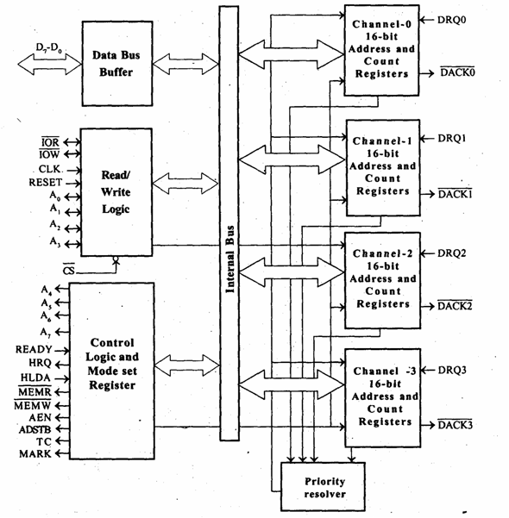
8257 DMA controller –Functional block diagram

Slide 41
Functions of 8257
Acquires the control of the system bus
Acknowledge the requesting peripheral that it is connected to the highest priority channel
Generates the appropriate memory and I/O read ,read/write control signals that cause the peripheral to receive or deposit a data byte directly from or to the addressed location in memory.

Slide 42
Functional Blocks
Data Bus buffer
Read/Write logic
Control Logic
4 DMA channels
2 programmable 16bit registers
One is used to program the starting address of the memory location for DMA data transfer.(Address register)
Second one is used to program 14 bit count value and a 2 bit code for type of DMA transfer.(Count register)

Slide 43
DATA BUS BUFFER:
It contain tristate ,8 bit bi-directional buffer.
Slave mode ,it transfer data between microprocessor and internal data bus.
Master mode ,the outputs A8-A15 bits of memory address on data lines(Unidirectional).
READ/WRITE CONTROL LOGIC:
It control all internal Read/Write operation.
Slave mode ,it accepts address bits and control signal from microprocessor.
Master mode ,it generate address bits and control signal.

Slide 44
Control logic block:
It contains ,
Control logic
Mode set register and
Status Register.
CONTROL LOGIC:
Master mode ,It control the sequence of DMA operation during all DMA cycles.
It generates address and control signals.
It increments 16 bit address and decrement 14 bit counter registers.
It activate a HRQ signal on DMA channel Request.
Slave mode it is disabled.

Slide 45
*Two operating Modes:-
Slave/ Programming
Master/DMA mode
* Types of DMA transfer:
Read Transfer(DMA Read)
Data is transferred from memory to I/O device.
Write Transfer
Data is transferred from I/O device to memory
Verify transfer
It is used by the peripheral device to verify the data that has been recently transferred

Slide 46
DMA address register
Each DMA channel has one DMA address register.
The function is to store the address of the starting memory location, which will be accessed by the DMA channel.
The starting address of the memory block which will be accessed by the device is first loaded in the DMA address register of the channel.
The device that wants to transfer data over a DMA channel, will access the block of the memory with the starting address stored in the DMA Address Register.

Slide 47
Terminal Count Register
16-bit register is used for ascertaining that the data transfer through a DMA channel ceases or stops after the required number of DMA cycles.
The low order 14-bits of the terminal count register are initialised with the binary equivalent of the number of required DMA cycles minus one.
After each DMA cycle, the terminal count register content will be decremented by one and finally it becomes zero after the required number of DMA cycles are over.

Slide 48
The bits 14 and 15 of this register indicate the type of the DMA operation (transfer).
If the device wants to write data into the memory, the DMA operation is called DMA write operation.
Bit 14 of the register in this case will be set to one and bit 15 will be set to zero.

Slide 49
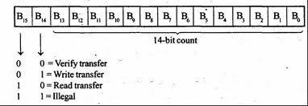
Count Register

Slide 50
Mode Set Register
To program various features of 8257.
Used to program the following features:
Enable/Disable a channel
Fixed/rotating priority
Stop DMA on terminal Count
Extended/normal write time
Auto reloading of channel-2

Slide 51
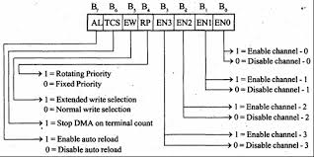
8257- Mode Set Register -Format

Slide 52
Priority modes of 8257
Fixed Priority mode
Each device connected to the channel assigned a fixed priority.
DRQ0 has the highest priority and DRQ3 has the lowest.
Rotating Priority mode
Priorities assigned to the channels are not fixed.
After the device in the channel gets serviced, assigned a lowest priority.

Slide 53
Mode Set Register
is to enable the DMA channels individually and also to set the various modes of operation.
The DMA channel should not be enabled till the DMA address register and the terminal count register contain valid information.
Bo-B3 enable one of the four DMA channels of 8257.
If the TC STOP bit is set, the selected channel is disabled after the terminal count condition is reached, and it further prevents any DMA cycle on the channel

Slide 54
auto load bit
if set, enables channel 2 for the repeat block chaining operations.
The channel 3 registers are used to store the DMA starting address and terminal count.
The extended write bit,
if set to ‘1’, extends the duration of MEMW and IOW signals
this is useful in interfacing the peripherals with different access times.

Slide 55
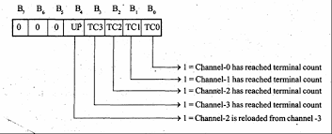
8257- Status register-Format

Slide 56
lower order 4-bits
contain the terminal count status for the four individual channels.
Update flag
not affected by the read operation
only be cleared by resetting 8257 or by resetting the auto load bit of the mode set register

Slide 57
8257 Operation
When a peripheral device requires a DMA, it will assert DRQ signal high
When the DRQ of a channel is asserted high and if the channel is enabled then 8257 will assert HRQ high.
When 8085 processor receives a high signal on its HOLD pin , it will complete the current instruction execution and then drive all its buses to tri-state, and will assert acknowledge signal HLDA as high.

Slide 58
8257 will send an acknowledge signal to the peripheral by asserting –DACK low.
The 8257 sends AEN high, which enables address latch. Also ADSTB signal is asserted high. Then, the content of address register is incremented by one and count register is decremented by one.
Also the 8257 asserts appropriate read and write control signals to perform DMA transfer.
After performing 1 byte transfer , steps 5 and 6 are repeated again and again, until terminal count (TC).

Slide 59
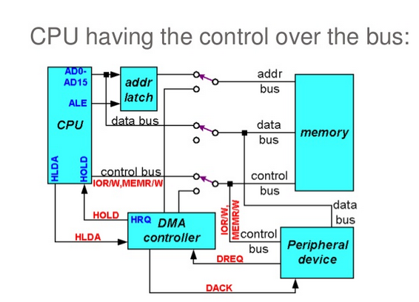

Slide 60
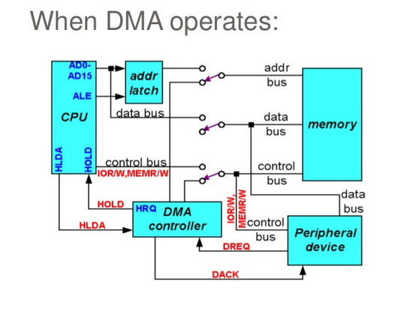

Slide 61
8255-Programmable Peripheral Interface(PPI)
Widely used, programmable parallel I/O device.
General purpose I/O device that can be used with almost any microprocessors.
Has 24 I/O pins that can be grouped primarily into two 8 bit parallel ports:
A and B, with the remaining 8 bits as Port C.
The 8 bits of port C can be used as individual bits or be grouped into two 4 bit ports :
C Upper (CU) and C Lower (CL).
The Functions are defined by writing a control word in the control register.

Slide 62
used in two modes:
Bit set/Reset (BSR) mode
used to set or reset the bits in port C
I/O mode
further divided into 3 modes:
mode 0
all ports function as simple I/O ports.
mode 1
is a handshake mode
Port A and/or Port B use bits from Port C as handshake signals.
two types of I/O data transfer can be implemented: status check and interrupt.
mode 2.
Port A can be set up for bidirectional data transfer using handshake signals from Port C, and Port B can be set up either in mode 0 or mode 1.

Slide 63
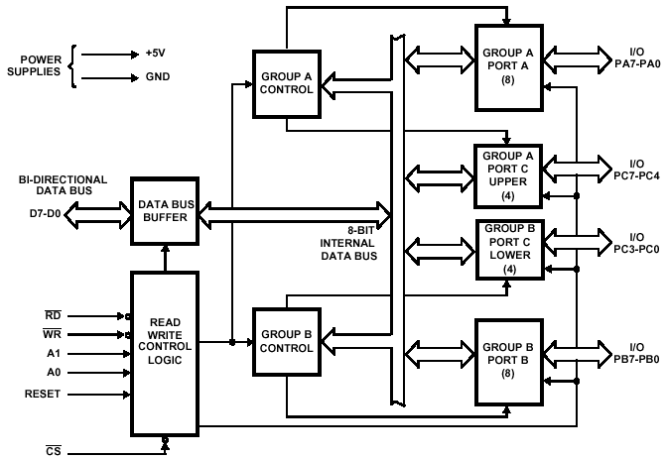
8255-Functional Block diagram

Slide 64

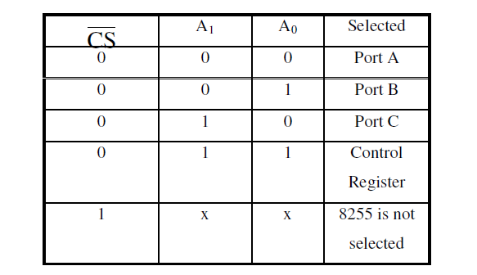
Control Logic of 8255
enables the Read operation. When the signal is low, microprocessor reads data from a selected I/O port of 8255.
WR:
Active –low signal that enables the write operation
RESET:
It clears the control register and sets all ports in input mode
CS,A0,A1:
These are device select signals that are connected to a decoded address and A0,a1 are connected to A0,A1 of MP

Slide 65
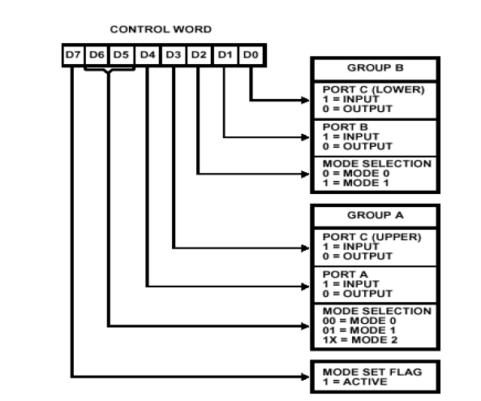
Control Word Format

Slide 66
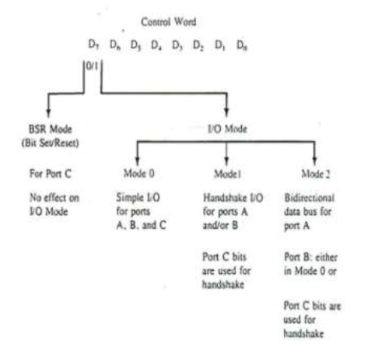

Slide 67
BSR Mode
Allows to set or reset any of the 8-bits of port-C by writing appropriate control word in the control word register.
I/O operations of Port-A and PORT-B are not disturbed.

Slide 68
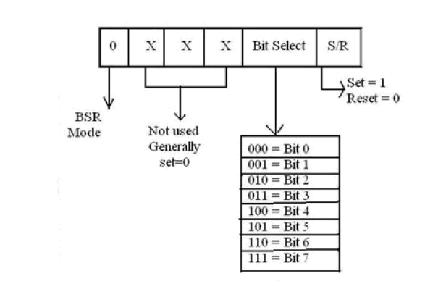
BSR Mode

Slide 69
I/O Modes
Mode 0 : Simple Input or Output
Port A and Port B are used as two simple 8-bit I/O ports and Port C as two 4-bit I/O ports.
Each port (or half-port, in case of Port C) can be programmed to function as simply an input port or an output port.
The input/output features in mode 0 are :
Outputs are latched, Inputs are not latched. Ports do not have handshake or interrupt capability.

Slide 70
Mode 1 : Input or Output with handshake
handshake signals are exchanged between the microprocessor and peripherals prior to data transfer.
The ports (A and B) function as 8-bit I/O ports.
Can be configured either as input or output ports.
Each port (Port A and Port B) uses 3 lines from port C as handshake signals.
The remaining two lines of port C can be used for simple I/O functions. Input and output data are latched and Interrupt logic is supported

Slide 71
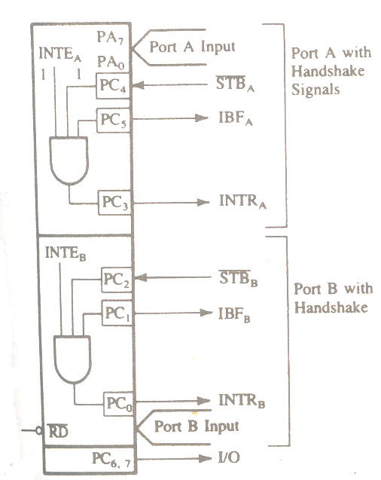
Mode 1 : Input control signals

Slide 72
STB
Active low signal generated by the peripheral device that it has transferred a byte.8255 generates an OBF and INTR signals in response to that.
IBF
Active low signal issued as an acknowledgement by 8255 to indicate that the input latch has received the data byte.
Resets when MP reads the data.
INTR
Output signal used to interrupt the MP
Generated when STB,IBF,INTE are at logic 1.

Slide 73
INTE
Internal flipflop to a port to generate INTR
2 flipflops are set or reset in BSR mode.
INTE_{A} is disabled through PC4 and INTE_{B} is disabled through PC2.

Slide 74
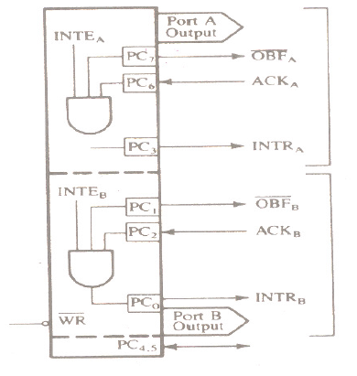
Mode1:Output Control Signals

Slide 75
OBF
Output signal that goes low when MP writes data into the output latch of 8255.
ACK
Input signal from peripheral that must output a low when peripheral receives data from output ports of 8255.
INTR
Output signal,set by the rising edge of ACK signal.
Can be used to interrupt the MP to request to the next data byte for output.
Set when OBF,ACK & INTE are at logic 1.

Slide 76
INTE
Internal flipflop to a port to generate INTR
2 flipflops are set or reset in BSR mode.
INTE_{A} is disabled through PC6 and INTE_{B} is disabled through PC2.

Slide 77
Mode 2 : Bidirectional Data Transfer
used primarily in applications such as data transfer between the two computers or floppy disk controller interface.
Port A can be configured as the bidirectional port and Port B either in mode 0 or mode 1.
Port A uses five signals from Port C as handshake signals for data transfer.
The remaining three lines from Port C can
be used either as simple I/O or as handshake signals for Port B.

Slide 78
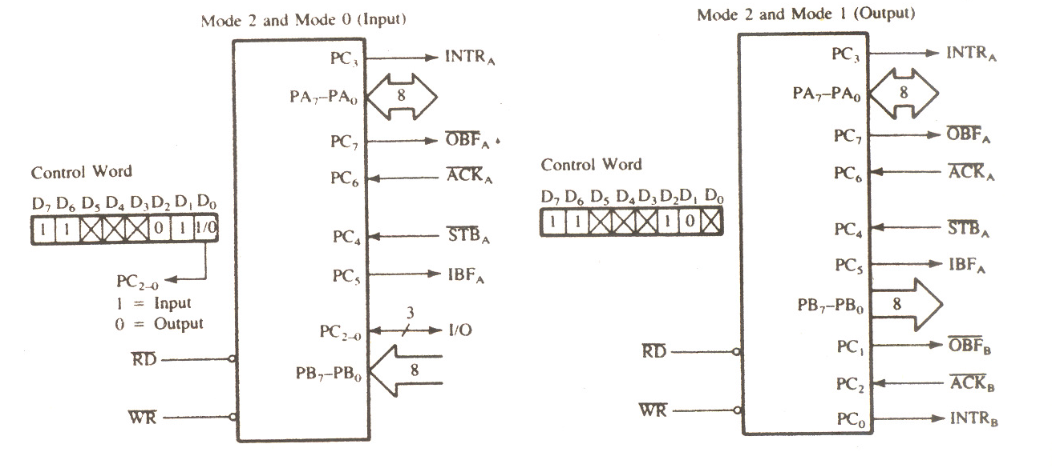
Mode2 Control Signals

